Slide 1
June, 2020
Annotated Bibliography Synthesis
of Resources & Organizations
Collected by DSI’s Advisory Working Group to
inform the development of the Disability Training Curriculum

Slide 2
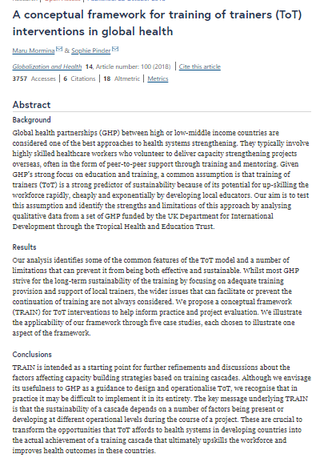

A Conceptual Framework for Training of Trainers (ToT) Interventions in Global Health
Mormina, M., Pinder, S. A conceptual framework for training of trainers (ToT) interventions in global health. Global Health 14, 100 (2018). https://doi.org/10.1186/s12992-018-0420-3. https://globalizationandhealth.biomedcentral.com/articles/10.1186/s12992-018-0420-3
“Global health partnerships (GHP) between high or low-middle income countries are considered one of the best approaches to health systems strengthening. Given GHP’s strong focus on education and training, a common assumption is that training of trainers (ToT) is a strong predictor of sustainability because of its potential for upskilling the workforce rapidly, cheaply and exponentially by developing local educators.”
This articles works to “identify the strengths and limitations of this approach by analyzing qualitative data from a set of GHP funded by the UK Department for International Development through the Tropical Health and Education Trust.”

Slide 3
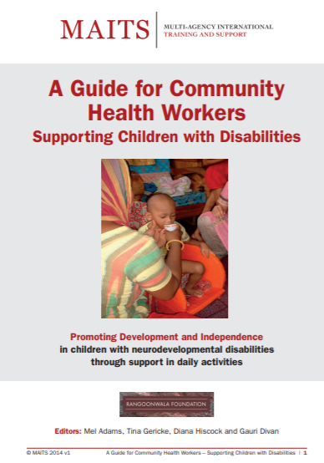
A Guide for Community Health Workers Supporting Children with Disabilities
Adams, M., Gericke, T., Hiscock, D., & Divan, G. (Eds.). A Guide for Community Health Workers Supporting Children with Disabilities. (2014). https://www.maits.org.uk/wp-content/uploads/2016/09/MAITS_CW_Manual_FINAL_REV_HiRes.1-24.pdf
“This resource is to be used as a guide for Community Health Workers (CHWs) to support parents in promoting the development and independence of their child with neurodevelopmental disabilities.”
“This resource places the emphasis on promoting activity and participation in a child’s daily life activities.”
“As such, this manual provides ideas on how to support the child during activities of daily living – taking particular account of their physical and communication abilities and needs – and does not include hands-on rehabilitation techniques that focus on specific impairments. It does however provide guidance on overall management and prevention of further disability.”

Slide 4
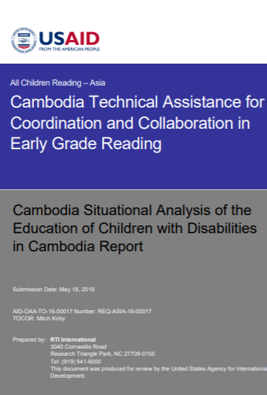
Cambodia Situational Analysis of the Education of Children with Disabilities in Cambodia Report
All Children Reading - Asia: Cambodia Technical Assistance for Coordination and Collaboration in Early Grade Reading. (2018). https://ierc-publicfiles.s3.amazonaws.com/public/resources/ACR-Cambodia_Final%20Cambodia%20Disabilty%20Situation%20Analysis%20Report.pdf
“To ground All Children Reading-Cambodia’s inclusive education programming, a situational analysis of the education of children with disabilities in Cambodia was conducted from November 2017 to February 2018.”
This document provides an analysis, presenting ten key findings, and provides several recommendations based on a significant multimodal assessment gathered through research, interviews and professional organizations.
“The Special Education Department (SED) of the Ministry of Education, Youth and Sport (MoEYS) and the Cambodian Disabled People’s Organization (CDPO) were key partners throughout the situational analysis.”

Slide 5
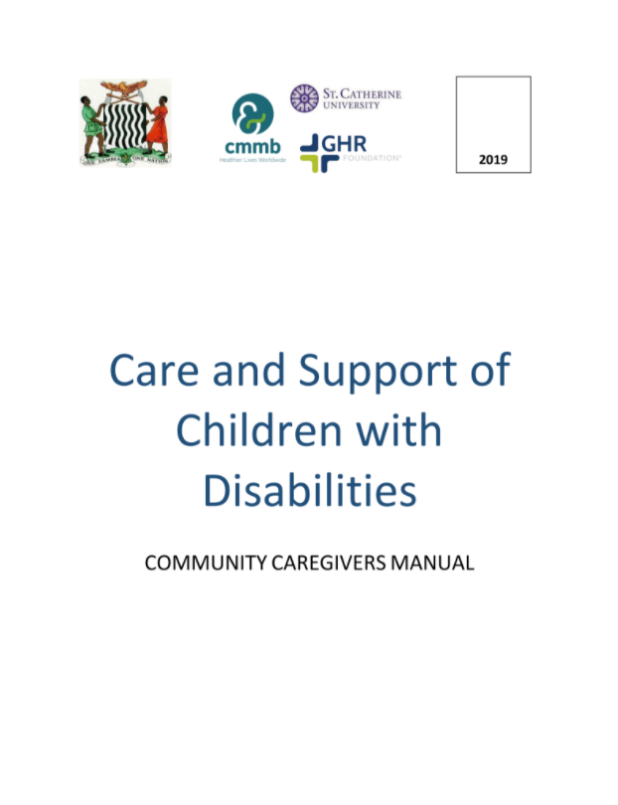
Care and Support of Children with Disabilities: Training of Trainers
Zambia ‘Care and Support of Children with Disabilities’ Training of Trainers in collaboration by GHR Foundation, CMMB Zambia & Saint Catherine University (2019). For more information on this resource, email info@ds-international.org
The goal of this Training of Trainers (TOT) process is to give new trainers the background knowledge, skills, and practical experience to provide this Kusamala+ disability training to community health workers who work directly with families and their children with disabilities in the community.

Slide 6
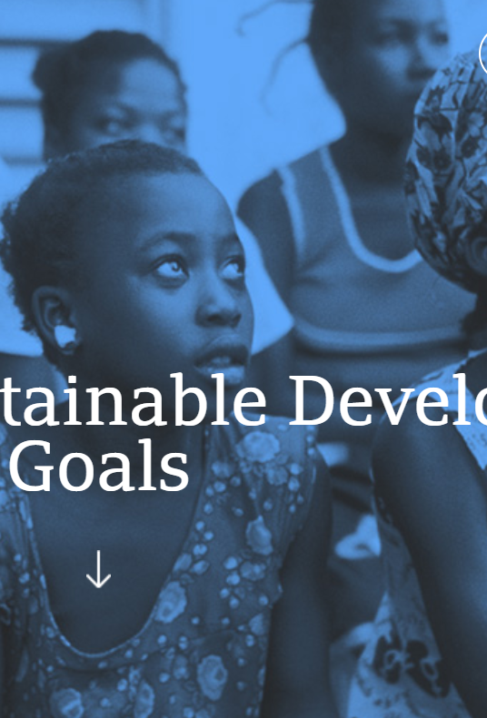
Data for the Sustainable Development Goals
Data for the Sustainable Development Goals. UNESCO UIS. (2020). http://uis.unesco.org/
“The UNESCO Institute for Statistics (UIS) is the official and trusted source of internationally-comparable data on education, science, culture and communication.”
“As the official statistical agency of UNESCO, the UIS produces a wide range of state-of-the-art databases to fuel the policies and investments needed to transform lives and propel the world towards its development goals.”
“The UIS provides free access to data for all UNESCO countries and regional groupings from 1970 to the most recent year available.”

Slide 7
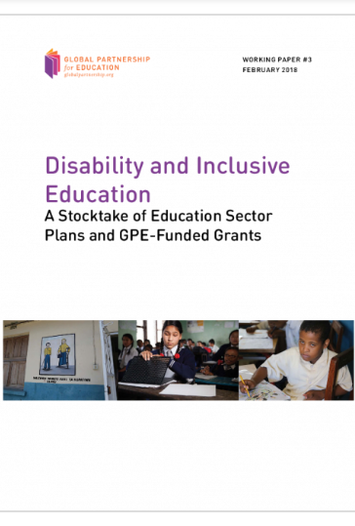
Disability and inclusive education -
A stocktake of education sector plans and GPE-funded grants
Disability and inclusive education - A stocktake of education sector plans and GPE-funded grants. GPE. (2018). https://www.globalpartnership.org/content/disability-and-inclusive-education-stocktake-education-sector-plans-and-gpe-funded-grants
“This report documents progress and highlights the need to step up support to Global Partnership for Education partner countries on disability and inclusive education, to improve consideration of issues around disability and inclusion in education sector analysis and sector planning processes…”
“This means ensuring that girls and boys with disabilities are not only able to access their right to a quality education in a nurturing environment, but also, through education, become empowered to participate fully in society, and enjoy full realization of their rights and capabilities.”

Slide 8
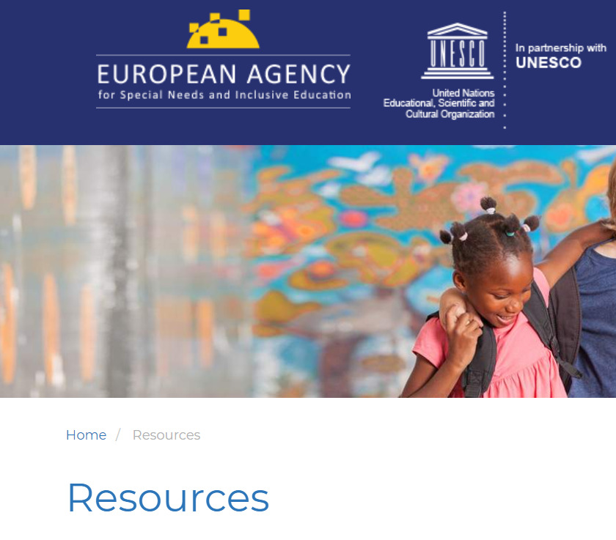
European Agency for Special Needs and Inclusive Education Resources
“Resources” Inclusive Education in Action. (2020). http://www.inclusive-education-in-action.org/resources
“The IEA resource base features a wide range of resources including international normative instruments, national policy and legislative documents, guidelines, research policy papers and practical tools.”
“It covers a collection of topics such as inclusive pedagogy and practices, professional development, language of instruction, curriculum, and the physical learning environment. It will be regularly updated as new resources become available.”

Slide 9
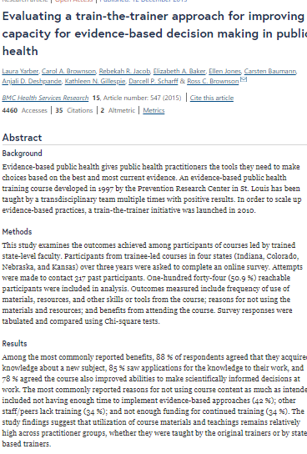
Evaluating a train-the-trainer approach for improving capacity for evidence- based decision making in public health
Yarber, L., Brownson, C.A., Jacob, R.R. et al. Evaluating a train-the-trainer approach for improving capacity for evidence-based decision making in public health. BMC Health Serv Res 15, 547 (2015). https://doi.org/10.1186/s12913-015-1224-2. https://bmchealthservres.biomedcentral.com/articles/10.1186/s12913-015-1224-2
“Evidence-based public health gives public health practitioners the tools they need to make choices based on the best and most current evidence. An evidence-based public health training course developed in 1997 by the Prevention Research Center in St. Louis has been taught by a transdisciplinary team multiple times with positive results. In order to scale up evidence-based practices, a train-the-trainer initiative was launched in 2010.”
This article provides information regarding the results of the train-the-trainer initiative.

Slide 10
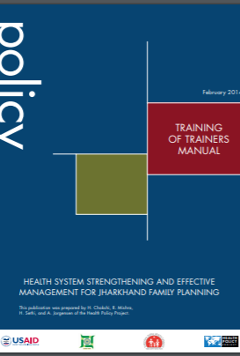
Health System Strengthening and Effective Management for Jharkhand Family Planning
Chokshi, H., Mishra, R., Sethi, H., & Jorgensen, A. Health System Strengthening and Effective Management for Jharkhand Family Planning. Health Policy Project. (2014). https://www.healthpolicyproject.com/index.cfm?id=publications&get=pubID&pubId=225
“This is one resource in a toolkit developed as an aid a community health capacity-building program in the Jharkhand. The Training of Trainers Manual and accompanying PowerPoint presentations are to build participants' skills to become trainers of district- and block-level managers in health systems strengthening and effective management to improve Family Planning programming.”

Slide 11
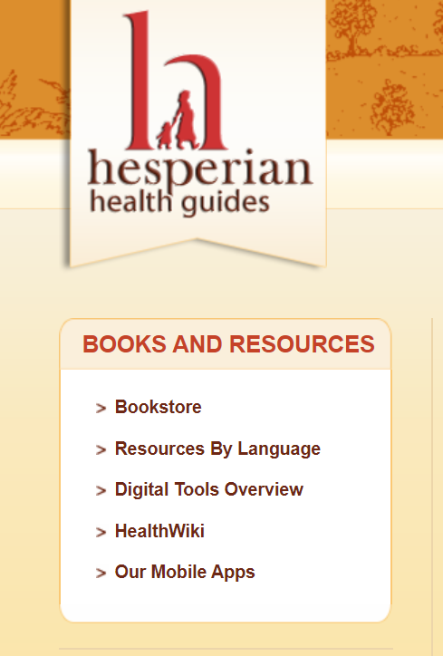
Hesperian Health Guides
“Digital Tools Overview.” Hesperian Health Guides. https://hesperian.org/books-and-resources/digital-commons/
“Hesperian now offers a variety of digital tools for health promotion, designed for people with limited computer or internet access.”
“Each tool represents thousands of hours of writing, production, field testing, translation, and digital adaptation. Taken together, they form the Hesperian Digital Commons, a collaborative project to re-imagine our trusted print materials through the innovative use of technology.”

Slide 12
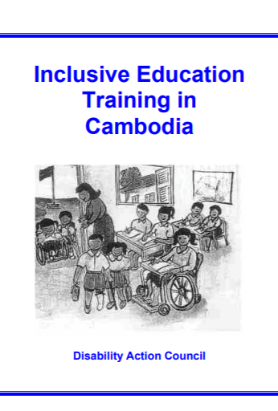
Inclusive Education Training
in Cambodia
Thomas, P. Inclusive Education Training in Cambodia. Kong V. & Disability Action Council Cambodia. (2003). https://www.eenet.org.uk/resources/docs/cambodia.pdf
“These materials are an in-service teaching training course for mainstream primary school teachers. The materials were first used to train teachers in the Project’s pilot site and have subsequently been formally recognized by the Cambodian Ministry of Education, Youth and Sport.”

Slide 13
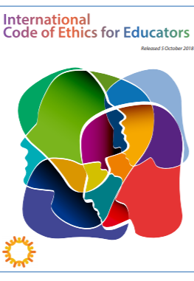
International Code of Ethics for Educators
“International Code of Ethics for Educators.” Childhood Education International, (2018). http://ceintl.wpengine.com/what-we-do/icoee/
“The ICoEE has been designed as a global code that reflects internationally accepted values and principles of human rights, including philosophies about education, human development, and learning that are embedded within United Nations declarations and international agreements.”
“It may be used and applied by educators around the world as a tool for critical reflection and elevating professional aspirations.”

Slide 14

Kupenda
Kupenda (“love” in Kiswahili) for the Children is a US-based nonprofit that equips children with disabilities to achieve their God-given potential through advocacy, education, and medical intervention.
In partnership with Kuhenza, their innovation center in the Kilifi region of Kenya develops, tests, and refines disability training programs that are now also being used in parts of Tanzania, Sierra Leone, Zambia and Haiti and are relevant for use in all developing nations.
They work in the following ways:
  Educating families and communities about the rights of children with disabilities and how to support them by advocating for their medical care, education, legal rights, and inclusion in all aspects of society.
  Supporting children with disabilities to access appropriate, high-quality education while supporting the staff and infrastructure of their schools.
  Connecting children with disabilities to appropriate medical services including surgeries, medications, and therapy.
https://kupenda.org/

Slide 15
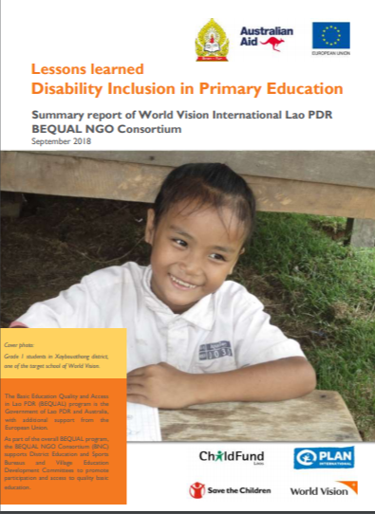
Lessons learned - Disability Inclusion in Primary Education
Lessons Learned Disability - Inclusion in Primary Education. (2018). https://resourcecentre.savethechildren.net/library/lessons-learned-disability-inclusion-primary-education
“World Vision International in Lao PDR implemented activities supporting inclusive education for children with disabilities in 22 villages in the district of Xaybouathong, Khammouane province from August 2017 - September 2018, under the umbrella of the BEQUAL Ngo Consortium (BNC) project.”
“This disability inclusion component was implemented in addition to other interventions aimed at increasing access and participation in primary schools, carried out by the BNC partnership in six districts… The report outlines the key lesson learned and recommendations for future intervention in Inclusive Education in Lao PDR.”

Slide 16
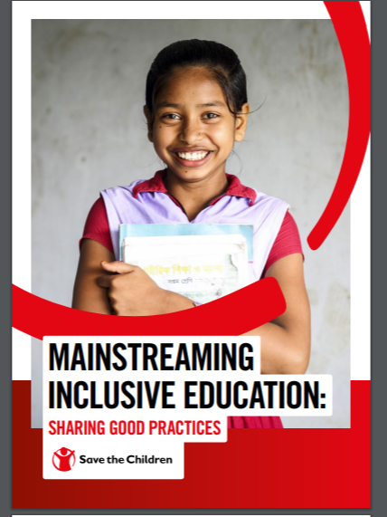
Mainstreaming Inclusive Education: Sharing Good Practices
Mainstreaming Inclusive Education: Sharing Good Practices. Save the Children. (2019). https://resourcecentre.savethechildren.net/node/15216/pdf/inclusive_education_report_2019_0.pdf
“The primary aim of this documentation is to provide a deeper understanding of how projects have applied more inclusive concepts in not only changing the lives of children with disabilities, those living in poverty or children from ethnic minority populations, their families and communities, but in catalyzing changes in policies and practices to the education system to benefit all learners.”

Slide 17
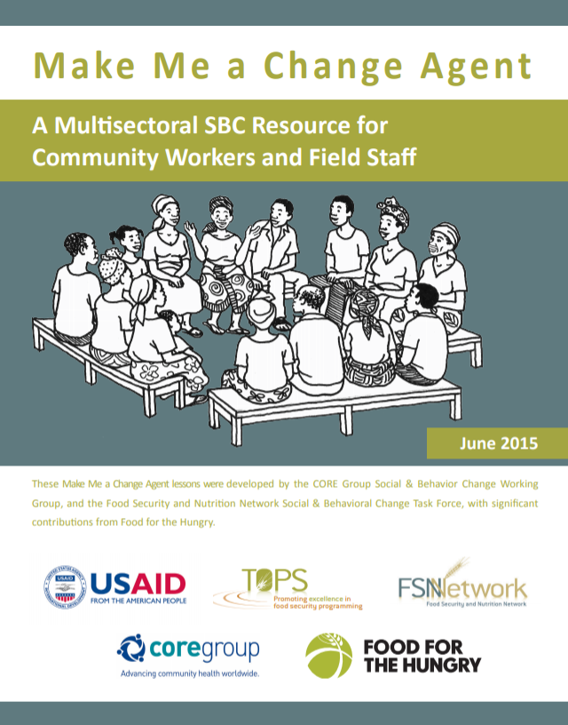
Make Me a Change Agent
Make Me a Change Agent: A Multisectoral SBC Resource for Community Workers and Field Staff. CORE Group and FSN Network. (2015). https://www.fsnnetwork.org/make-me-change-agent-multisectoral-sbc-resource-community-workers-and-field-staff
“This guide was developed drawing on the experiences of Social and Behavioral Change (SBC) specialists from multiple non-governmental organizations (NGOs) who collaborated to identify the necessary skills related to behavior change, establish a lesson plan format and preferred training methodology, design the lessons, develop the handouts and visual aids, and review and field test the materials.

Slide 18

Mobility International USA
Founded in 1981, Mobility International USA (MIUSA) is a disability-led non-profit organization headquartered in Eugene, Oregon, USA advancing disability rights and leadership globally.
MIUSA is a cross-disability organization serving people with a broad range of disabilities.
Their mission: To empower people with disabilities to achieve their human rights through international exchange and international development.
Their programming work includes a Training of Trainers approach in countries including Vietnam, Armenia, & Guatemala.
https://www.miusa.org/

Slide 19
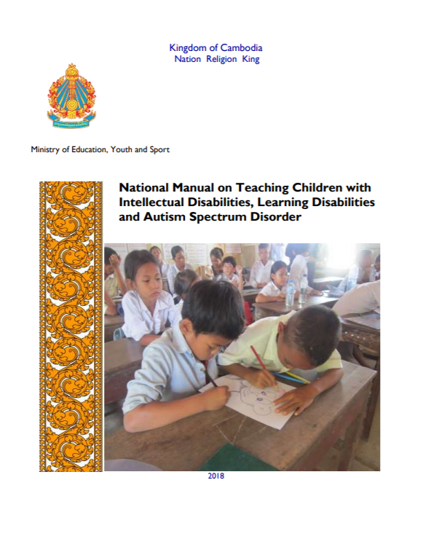
National Manual on Teaching Children
with Intellectual Disabilities, Learning Disabilities and Autism Spectrum Disorder
The Kingdom of Cambodia, MoEYS “National Manual on Teaching Children with Intellectual Disabilities, Learning Disabilities and Autism Spectrum Disorder” (2018). https://95a7be90-4c71-476f-8396-0cb464a181fe.filesusr.com/ugd/086462_fd688b1e3afd4739968c46db46d120ab.pdf
"In collaboration with national and international stakeholder in Cambodia, the Ministry of Education, Youth & Sport (MoEYS) has developed a national teacher’s manual on educating children with intellectual disabilities in order to strengthen capacity and quality of teachers… This manual offers theory-to practice knowledge to teachers with appropriate content and methodology for responding to learning needs of children with intellectual disabilities.”
“This Manual has been developed with an aim to develop teachers’ knowledge, skills and experience in identifying and screening for children with special needs, developing personal development plans, and using simple techniques, materials and games to help children with intellectual disabilities, learning disabilities and autism spectrum disorder to learn effectively and develop further.”

Slide 20
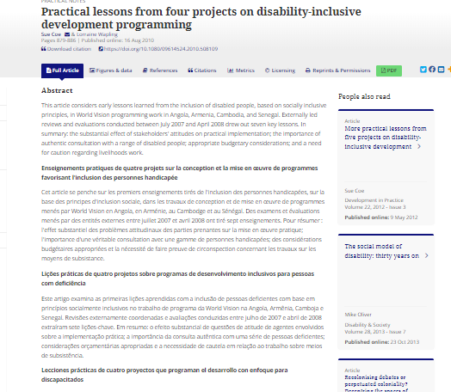
Practical lessons from four projects
on disability-inclusive development programming
Sue Coe. More practical lessons from five projects on disability-inclusive development. Development in Practice 22:3, pages 400-408. (2012). https://www.tandfonline.com/doi/full/10.1080/09614524.2010.508109
“This article considers early lessons learned from the inclusion of disabled people, based on socially inclusive principles, in World Vision programming work in Angola, Armenia, Cambodia, and Senegal.”
This article highlights results such as, “the substantial effect of stakeholders' attitudes on practical implementation; the importance of authentic consultation with a range of disabled people; appropriate budgetary considerations; and a need for caution regarding livelihoods work.”

Slide 21
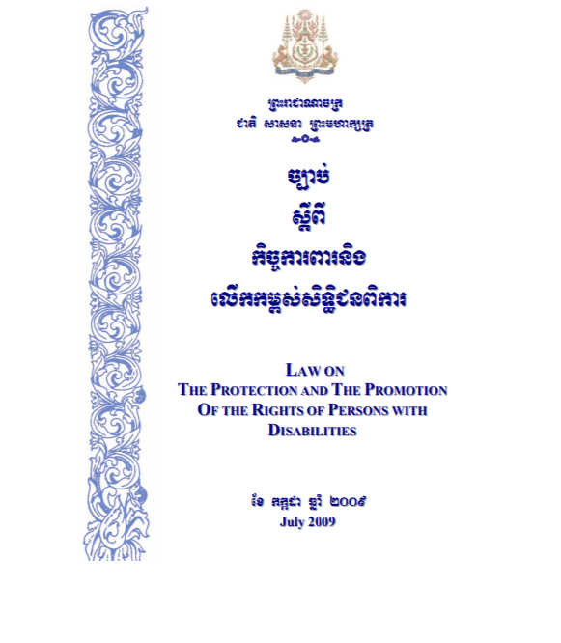
Royal Government of Cambodia Law on the Protection and Promotion of the Rights of Persons with Disabilities
Law on the Protection and Promotion of the Rights of Persons with Disabilities. Royal Government of Cambodia. (2009). http://dac.org.kh/images/pictures/pdf/english/Law-on-the-Protection-and-the-Promotion-of-the-Rights-of-Persons-with-Disabilities-2009.pdf
"The goal of this law is to protect and promote the rights of persons with disabilities within the Kingdom of Cambodia”
“The Law on the Protection and the Promotion of Rights of Persons with Disabilities is very important in addressing the issues facing people with disabilities in society together with the implementation of other Royal Government Policies in promoting the welfare of people with disabilities.”
“These include the National Strategic Plan and policies of other ministries, institutions and authorities at all levels. This law will protect and promote the basic rights of people with disabilities, reduce discrimination, provide equal opportunities for employment.”

Slide 22
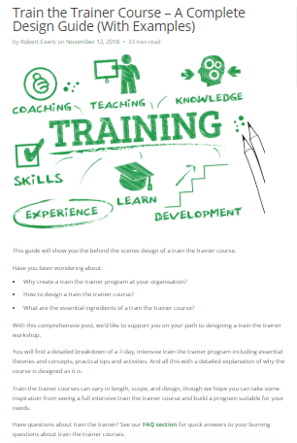
SessionLab Train the Trainer Course
Cserti, Robert. “Train the Trainer Course - A Complete Design Guide (With Examples).” SessionLab, (2020). www.sessionlab.com/blog/train-the-trainer/. https://www.sessionlab.com/blog/train-the-trainer/
“This guide will show you the behind the scenes design of a train the trainer course.” This provides information to develop a train the trainer program. This includes “a detailed breakdown of a 7-day, intensive train the trainer program including essential theories and concepts, practical tips and activities. And all this with a detailed explanation of why the course is designed as it is.”
This addresses the questions:
  “Why create a train the trainer program at your organization?”
  “How to design a train the trainer course?”
  “What are the essential ingredients of a train the trainer course?”

Slide 23
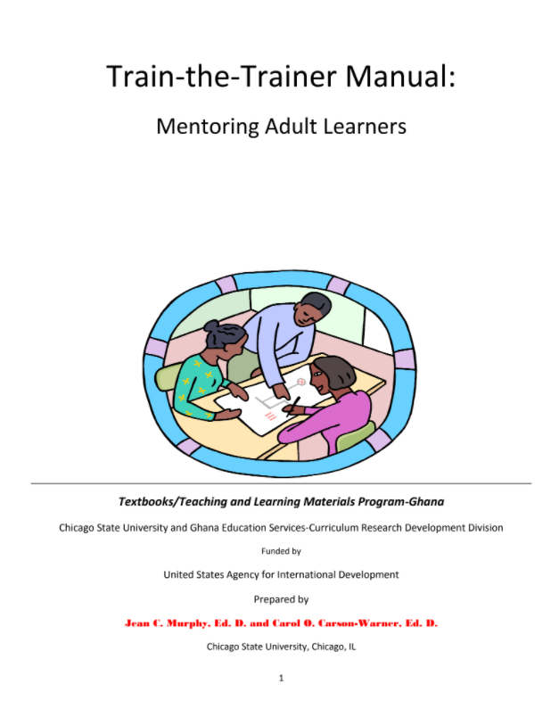
Train-the-Trainers Manual: Mentoring Adult Learners
Train-the-Trainers Manual: Mentoring Adult Learners. Chicago State University & Ghana Education Services-Curriculum Research Development Division. https://www.csu.edu/TLMP/documents/TLMPTraining-the-TrainerManual2.pdf
“This Train-the-Trainer Manual addresses the need for professionally designed trainings that enhance, extend, and build the capacity of the GES [ Ghana Education Service] to train a cadre of competent and well-trained mentor/trainers.”
The purpose of the Train-the-Trainer Manual is to provide mentor/trainers with competencies that will enable them to effectively mentor, facilitate knowledge acquisition, application, and skills in use of the TLMP [Teaching Learning Materials Program] Teacher’s Guides and Children’s Workbooks…”

Slide 24
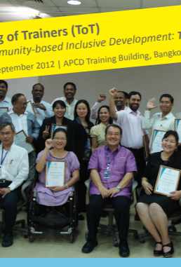
Training of Trainers (ToT) for the Community-based Inclusive Development: Towards Sustainability
Training of Trainers (ToT) for the Community-based Inclusive Development: Towards Sustainability. Asia-Pacific Development Center on Disability (APCD). (2012). http://apcdfoundation.org/?q=system/files/CBID%20in%20Sep.pdf
This ToT program “is specially designed to strengthen and to promote an on-going application of the Community Based Rehabilitation (CBR) Guidelines in the areas of disability and development.”
“The launching of the CBR Guidelines in October 2010 serves as a crucial step forward to enhance CBR projects and to improve the quality of life of people with disabilities in the community.”
“As such, the need for highly qualified CBID trainers has never been greater.” This guide is an example of a training resource.

Slide 25

Spoon Foundation
SPOON designs tools and trainings specifically tailored to improve the lives of vulnerable children. They partner with local organizations and governments to spread their curriculum and methodology to trainers and caregivers.
They use distance learning, a Training-of-Trainers approach, and an app ‘Count Me In’, to build the capacity of caregivers in local communities and institutions in essential nutrition and feeding care.
They advocate for policies, actions, and systems to sustain the impact of their work.
https://www.spoonfoundation.org/

Slide 26
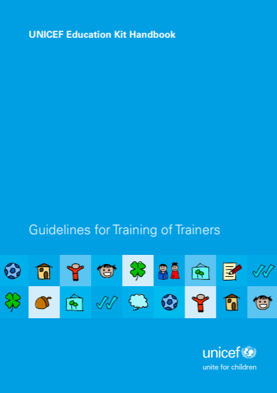
UNICEF Education Kit Handbook Guidelines for Training of Trainers
UNICEF Education Kit Handbook Guidelines for Training of Trainers. UNICEF. (2013). https://www.unicef.org/supply/media/661/file/guidelines-for-training-of-trainers-education-UNICEF-kit-handbook.pdf
“This Handbook aims at providing training and curricular guidance related to existing pre-packaged materials or kits. It is intended to strengthen the impact of UNICEF from the initial first response of pedagogical supplies to one of fostering learning, growth and development.”
“With the Handbook, the education kits, and proper teacher training, it will be possible to extend the utility of the individual kits, improving the quality of the initial education response in BTS initiatives.
  To provide curricular guidelines and instructions on how to use the teaching aids contained in the kits for teachers, caregivers and instructors working in emergency contexts. A printed copy of each curriculum is contained in the related kit.
  To provide training guidelines for the trainers involved in the emergency response.”

Slide 27
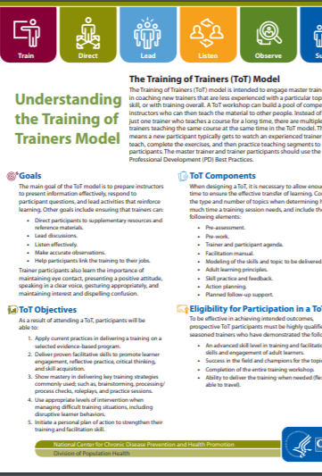
Understanding the Training of Trainers Model
Center for Disease Control. Understanding the Training of Trainers Model. National Center for Chronic Disease Prevention and Health Promotion. (2019). https://www.cdc.gov/healthyschools/professional_development/documents/17_279600_TrainersModel-FactSheet_v3_508Final.pdf
“The Training of Trainers (ToT) model is intended to engage master trainers in coaching new trainers that are less experienced with a particular topic or skill, or with training overall.”
“This resource outlines goals, objectives, components, participation eligibility, resources and definitions for ToT.”

Slide 28
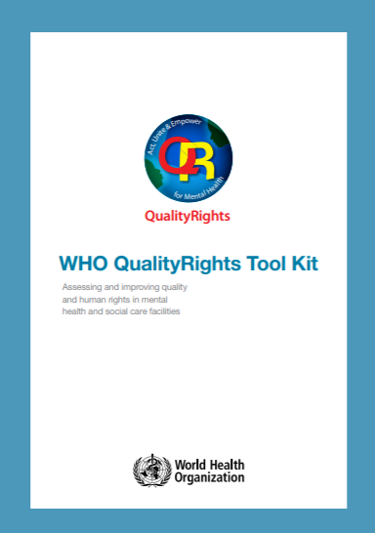
WHO QualityRights Tool Kit
WHO QualityRights Tool Kit. WHO. (2012). https://www.who.int/mental_health/publications/QualityRights_toolkit/en/
“The WHO QualityRights tool kit provides countries with practical information and tools for assessing and improving quality and human rights standards in mental health and social care facilities.”
“The Toolkit is based on the United Nations Convention on the Rights of Persons with Disabilities. The tool kit is designed for use in low-, middle- and high-income countries.”
“It provides practical guidance on:
  The human rights and quality standards that should be respected, protected and fulfilled in both inpatient and outpatient mental health and social care facilities;
  Preparing for and conducting a comprehensive assessment of facilities; and
  Reporting findings and making appropriate recommendations based on the assessment.”

